Slide 1
Design Pattern
Cefalo School

Slide 2
Problem-1
Basic Equation Evaluator
Addition
Subtraction
Multiplication
Complex Expression

Slide 3
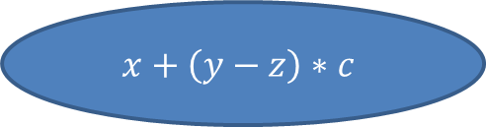




$$x+\left(y−z\right)∗c$$
$$x+\left(y−z\right)∗c$$
$$\left(y−z\right)∗c$$
x
$$y−z$$
c
$$y$$
z

Slide 4
Solution
Lets see some code ☻

Slide 5
Composite Pattern
Composite
Leaf
Composite
Leaf
Leaf
Leaf

Slide 6
More Practical Problem
Form Validation

Slide 7
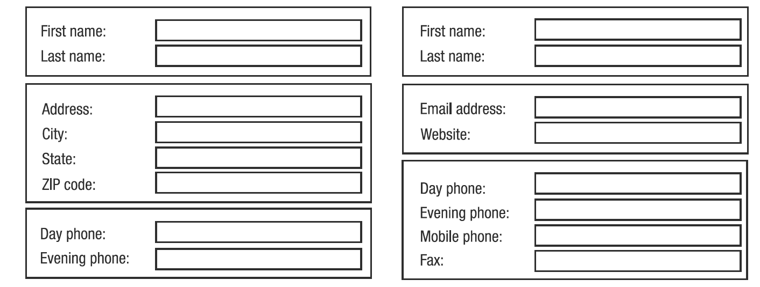
Form validation ( Contd.)

Slide 8
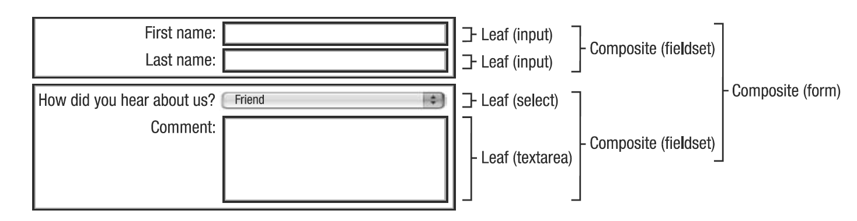
Form validation ( Contd.)

Slide 9
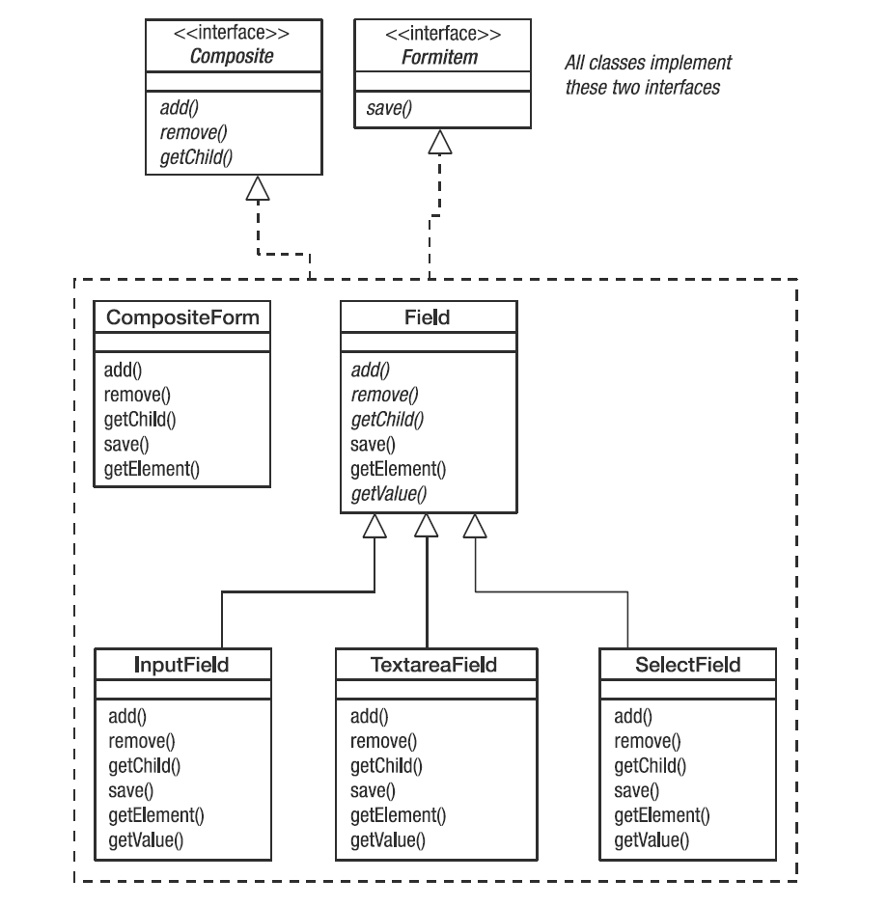
Form validation ( Contd.)

Slide 10
Composite Pattern
Leaf - the basic unit - the operation will be enacted upon this object
Composite - comprises of objects and/ or leaves
Has a relationship not is a relatioship
Notes:
A composite should have a HAS-A relationship with its children, not an IS-A relationship. A form has
fieldsets, and fieldsets have fields. A field is not a subclass of a fieldset. Because all objects within a composite
respond to the same interface, it might be tempting to think of them in terms of superclasses and subclasses,
but this is not the case. A leaf will not inherit from its composite.

Slide 11
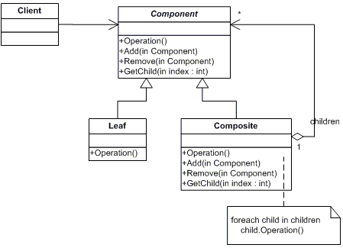
UML Diagram

Slide 12
Motivation
Group of objects
Uses composition

Slide 13
Real world library
java.awt.Component
Get request RESTful web service

Slide 14
Drawbacks
Large hierarchy creates performance problem.

Slide 15
Assignment
Form Validation
Create two to three types of forms comprises different form elements
Validate the form

Slide 16
Code Reference
https://github.com/rezaulsajib/composite

Slide 17
References
http://www.apress.com/9781590599082 (Chapter:9)
http://www.dofactory.com/net/composite-design-pattern

